Slide 1

JNTUA College of Engineering, Pulivendula Department of Computer Science Hospital Management
T. Siva Bhargav 16191A0552
S.Arun Kumar 16191A0550
B. Kavitha 16191A0533
K.Sunanda 17195A0502
Under the guidance of
Sri T. Niranjan Babu M.tech

Slide 2
Need for study: Introduction to Indian Health Care System
The need for an efficient and effective public health system in India is required.
In India , it is the responsibility of state government to take care of its citizens health.
Drawbacks to India's healthcare system today include
Low quality care
Lack of public health knowledge and low cost factor.
Barriers of access to services and medicines

Slide 3
Literacy Survey Data
India 145th among 195 countries in healthcare access, quality. http://timesofindia.indiatimes.com/articleshow/64283179.cms?utm_source=contentofinterest&utm_medium=text&utm_campaign=cppst
https://en.wikipedia.org/wiki/Public_health_system_in_India
Smart Hospital Management System: IEEE publisher
https://ieeexplore.ieee.org/document/5564121

Slide 4
Project Statement:
Although different Governments has been taking various development policies to provide best healthcare system, but still there are common issues in different areas of health care.
To help a government from these issue we bought a new project named "Hospital Management" .
These Project helps in Monitoring the progress, analyzing the existing techniques and failures of some revolutionary Development policies.

Slide 5
Hospital Management:
The Theme is divided into following modules.
1 . Analyzing the present procedures to Cure a Disease .
2. Performance of a Doctor.
3. Digital Appointment and Monitoring a Patient .

Slide 6
1.Analyzing The present curing procedures:
Based on the patient details and their status levels after treatment ,we get information like
a. How a procedure helps in curing a disease.
b. Failures of procedures
c. Drop outs during treatment procedure can also be known.

Slide 7
2.Performance of a Doctor:
By collecting data from patients , complete analysis on doctor is done
From these data , we will be able
a. To predict that doctor is expert in particular disease or not.
b. we will also able to know about the drawbacks of given doctor
Here a doctor has two possible predictions in evaluating i.e,
an expert doctor curing the disease in his area.
an inexpert doctor in a given area .

Slide 8
Cases for a Doctor non-expertise:
An nonexpert doctor in a given area .Here again we have two cases
a. A doctor is expert but there is lack of infrastructure.
b . A doctor is not efficient in given area but expert in another area.

Slide 9
3.Digital Appointment and Monitoring a Patient:
From the above two modules,
Whenever a patient wants treatment(in case of non-emergency) based upon his symptoms , diagnosis is done .Then he will have a direct appointment to that disease curing doctor.
Also we give timings for a patient, whose treatment is in progress ,to a busy doctor. These helps in reducing the time of waiting of a regular patient to a given doctor.

Slide 10
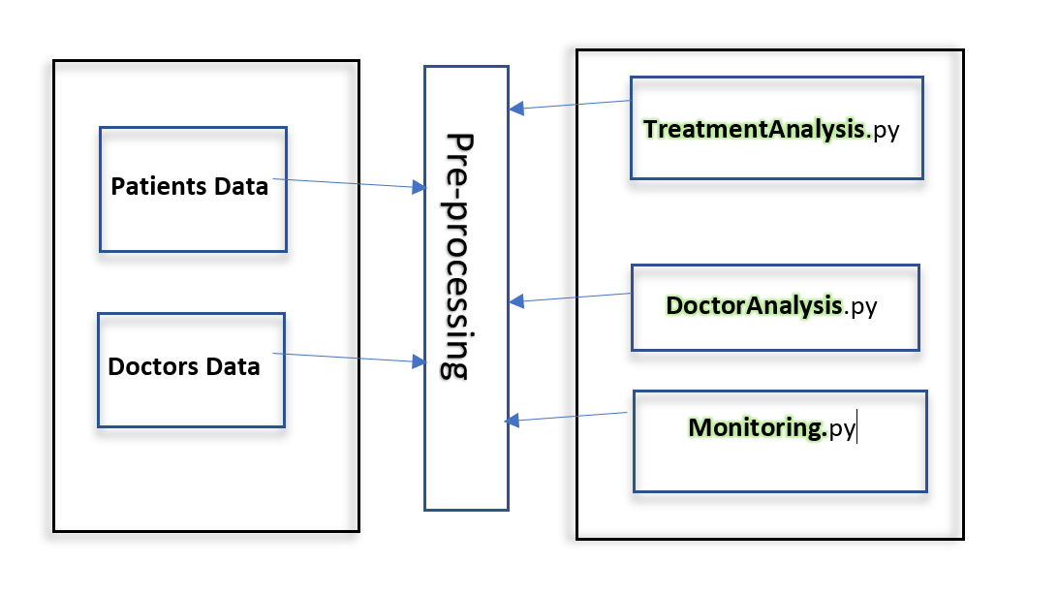
Architecture Model

Slide 11
TreatmentAnalysis Module:
Features:
Registration Number, Appointment Date, Patient Name, Doctor Id, Procedure, Medical Prescription, Patient Status, Disease etc…
Algorithm:
Random Forest
DoctorAnalysis Module:
Features:
Patient Id, Disease, Status_Before_Treatment, status_After_Treatement, Dropped_Out
Algorithm :
Decision Tree

Slide 12
Thank You

